Slide 1
Enhancing Runtime Wi-Fi MAC Re-randomization
Group Members
Muhammad Bin Waseem 2023403
Muhammad Shaheer 2023509
Muhammad Zaeem Nawaz 2023550

Slide 2

INTRODUCTION
Wi-Fi devices continuously broadcast MAC addresses.
Passive attackers can track devices by their MAC addresses using monitor mode.
Traditional MAC randomization fails due to persistence.
MAC A
Victim
Access point
Sniffing traffic
Sniffing traffic
MAC A : Rerandomized address unless reconnected manually
Attacker

Slide 3
SYSTEM MODEL
Implemented in NS3
Wi-Fi Configuration
IEEE 802.11g
YansWifiChannel
Unique PKT shared with each station.
Access point
Traffic Model
UDP traffic
1472-byte payload
1 packet/sec
100 sec simulation
Station A
Station B
Station C
YansWifiChannel : provide realistic delays and propagation loss

Slide 4
PROBLEM FORMULATION
AP and STA share PTK after WPA3 authentication.
Both compute synchronized ephemeral MAC addresses using PKT.
MACs change periodically after interval T during communication.
SN reset with MAC change
A passive attacker can:
sniff frames
observe MAC transitions
analyze timing patterns
correlate traffic-flow behavior
P​=P(T)×P(F∣T)×P(S∣T,F)
Where T= 30
1T 2T 3T 4T 5T
Abbreviations
PKT = Pairwise Transient Key
AP = Access Point
STA = Station
SN = sequence Number
P(T)= time relation
P(F|T) = Trafficflow
P(S|F,T)=SN Time and flow relation
MAC A Mac B MAC C MAC D MAC E
MAC A Mac B MAC C MAC D MAC E
Mac Rotation Time Predictable

Slide 5
ALGORITHMS : SAS-J & MIRAGE
MIRAGE
T= 17s ---> 41s ---> 22s ---> 35s
vMac0 = Hash(BaseMac + PKT +
cycleIndex + "ID_0“) vMac1 = Hash(BaseMac + PKT +
cycleIndex + "ID_1") Packet → vMac[toggle] toggle = 1 – toggle
RoundRobinDispacther()
MAC[0]
MAC[1]
Station
Access Point
SAS-J
SAS-J (Secure adaptive Synchornization with Jitter )
Interval T is pseudo random 15s <= T <= 45s (instead of constant 30s )
Seed = Hash(PTK || CycleIndex)
T_i = Random(Seed, 15s, 45s)
NextRotation= CurrentTime +T_i
Sn_{masked} =(Sn_{curr} – Sn_{offset})mod4096
Cycle Index is the current MAC rotation cycle increments every rotation.
Sequence number stored and reset to 0.
Datastream split into 2 virtual MACs MAC[0] and MAC[1] alternate.
Packets alternate between two addresses
Both AP and Station Compute new Address with same inputs. Therefore

Slide 6
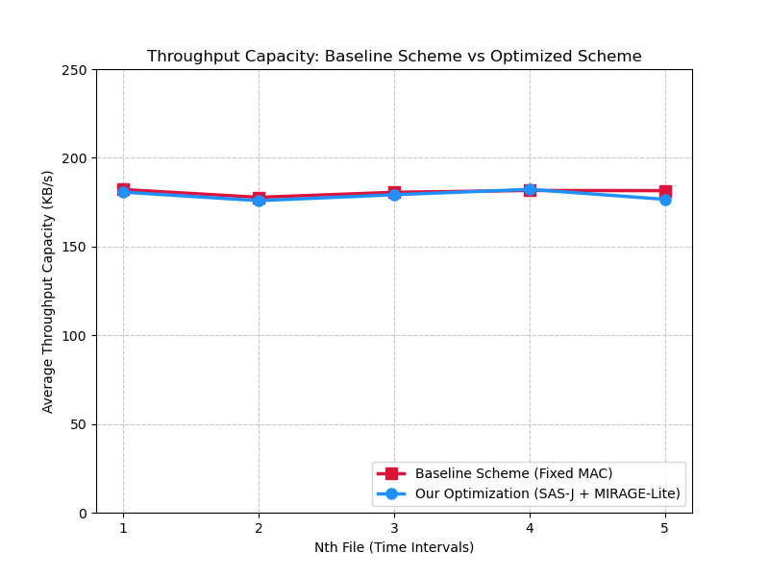
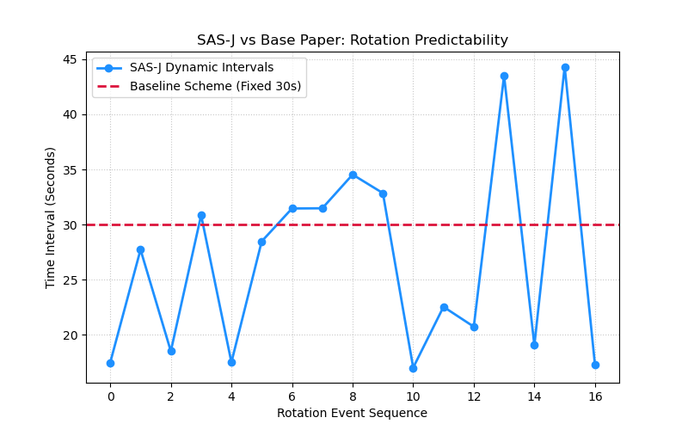
RESULTS
pseudo-random intervals (15–45s).
Randomized timing removes predictable temporal patterns.
Timing-based burst become harder
Average throughput remains stable.
introduce negligible computational overhead.
Network performance not effected.

Slide 7
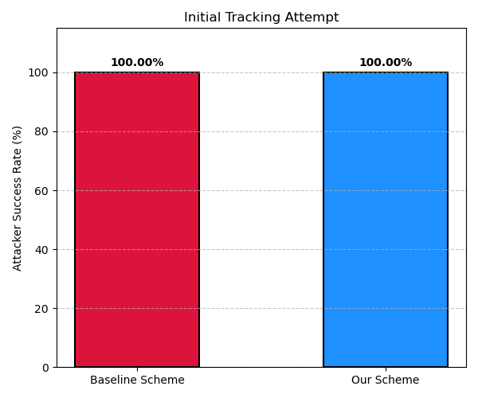
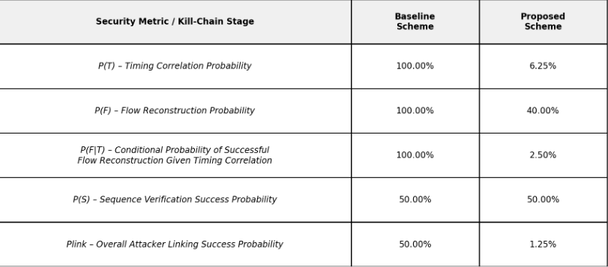
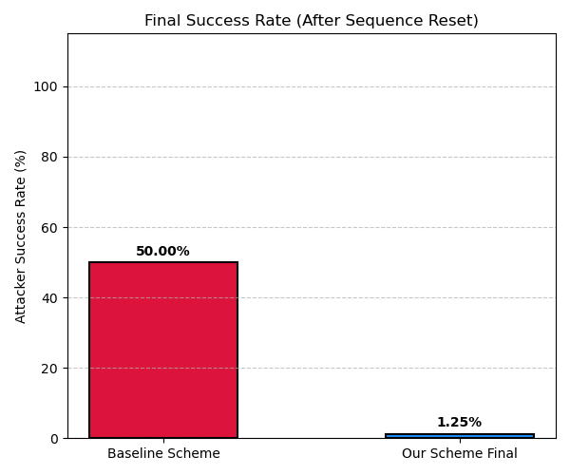
RESULTS
Before over the air rerandomization easily linkable due to session persistance
Timing and behavioral correlation attacks unreliable.
attacker left with no reliable linkage signal for device tracking.

Slide 8
THANK YOU

